Slide 1

HCI - Assignment n.2
Design and prototyping of an application using a human-centered approach
Final presentation and demo
Project Title: Car Sale Platform
Group: Francisco Teixeira, José Pereira, Luís Couto
Lab Class: P3
HCI 2021-2022

Slide 2
Introduction
Car Sale Platform
The digital world is an ever-growing presence in people's lives, becoming dominant especially in the marketing and sales department.
For a regular person looking to make a sale/purchase, having a platform to do so online is extremely important.
This project aims to do so by developing a platform, where people can easily create an account and buy/sell their vehicles, as well as check statistics on the market products and sales.
HCI 2021-2022
2

Slide 3
Project Objectives
Car Sale Platform
Have an environment that allows both knowledgeable and unknowledgeable computer users to have a smooth and easy to learn experience
Support a rich search option
Provide both simple and complex statistics on the market state
Help people make the best sale/purchase possible, by providing a platform with the means and information to do so
HCI 2021-2022
3

Slide 4


Personas
Name: João Ferreira Gender: Male
Age: 35 Profession: Car Salesperson
Background: Has been selling cars in his stand for 10 years, possesses some IT experience
Motivation: Seeks to expand his stands vehicle inventory
Goals: Buy cars with specific characteristics
Needs: A platform where he can search for cars with very specific characteristics in a simple and efficient way
Name: Maria Jesus Gender: Female
Age: 60 Profession: Literature Professor
Background: Has been teaching literature for 37 years, has little to none IT experience
Motivation: Needs to clear space in her garage
Goals: Sell her old car in the fastest way possible
Needs: A platform easy to use where she can put her car for sale, and know the price she is asking is fair
HCI 2021-2022
4

Slide 5
Scenarios
Scenario 1 - Maria has decided it’s finally time to buy a new car, but only has space in her garage for one. She chooses to sell her old car online, but isn’t entirely sure how much it is worth
Scenario 2 - João’s stand is doing well, and he notices the demand for cars with specific characteristics is increasing, but he is limited by his current inventory. So, he decided to search online for the specific car he wants
Scenario 3 - João wants to have a better understanding of the market and adapt his inventory and prices to the public needs. So, he needs to have an insight on what the latest trends in purchases are.
HCI 2021-2022
5

Slide 6
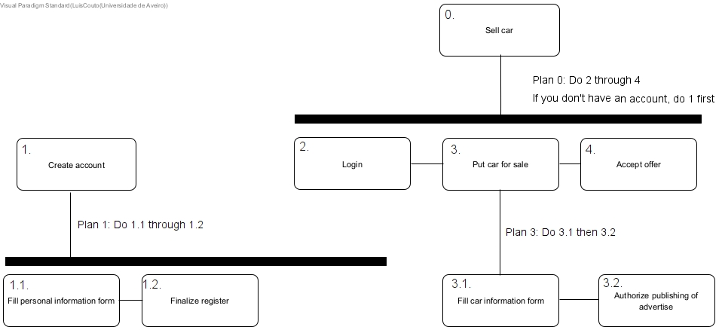
Tasks
Scenario 1
- Sell a car
Without the car sale platform, the seller would have to either go to a car dealership or find people to sell the car to by herself
By using the platform, the process is much quicker and can target a larger audience
HCI 2021-2022
6

Slide 7
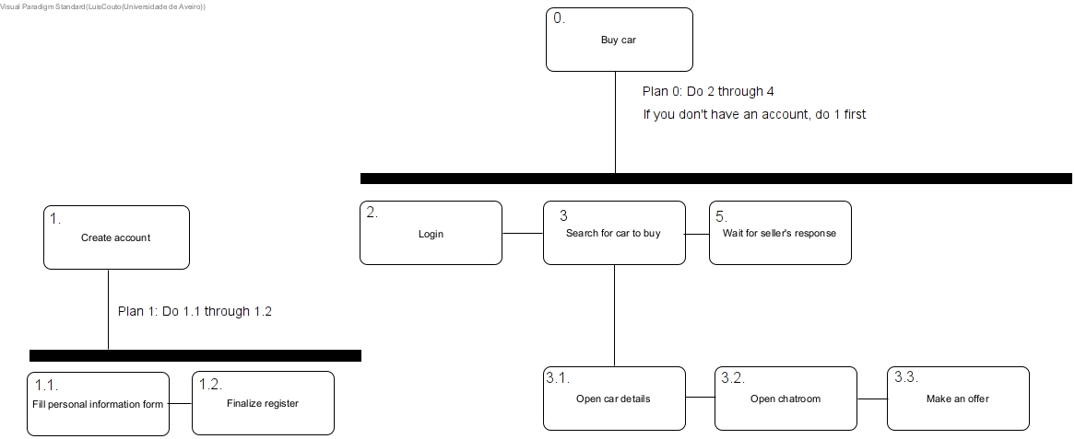
Tasks
Scenario 2
- Buy a specific car
Without the car sale platform, the buyer would by forced to look for the specific car in other stands, newspapers, etc.
By using the platform, he can quickly search for cars suited to his needs
HCI 2021-2022
7

Slide 8
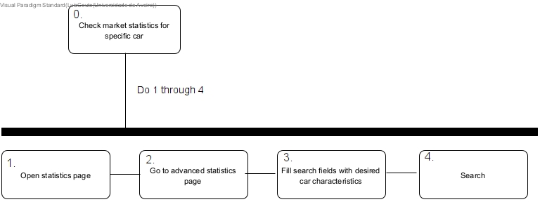
Tasks
Scenario 3
- Check the platform sales statistics for a determined car model
Without the car sale platform, the person looking to understand the market for the specific car would need to study and do research
By using the platform, it allows the person to have a much quicker insight on the prices of cars sold/for sale with the wanted characteristics
HCI 2021-2022
8

Slide 9
Requirements
Non-functional requirements
- Intuitive and easy-to-learn interface
- Reliable and maintainable platform, with low to no error occurrence
- Performance and scalability, showing equal use on low and high workload
Functional Requirements
- Authentication
- “Store-like” front to showcase cars and their information
- Rich search options
- Simple and complex statistics page to understand the market trends
- Support car sales, providing an extensive information form before creating the car advertisement
- Support car purchases
HCI 2021-2022
9

Slide 10
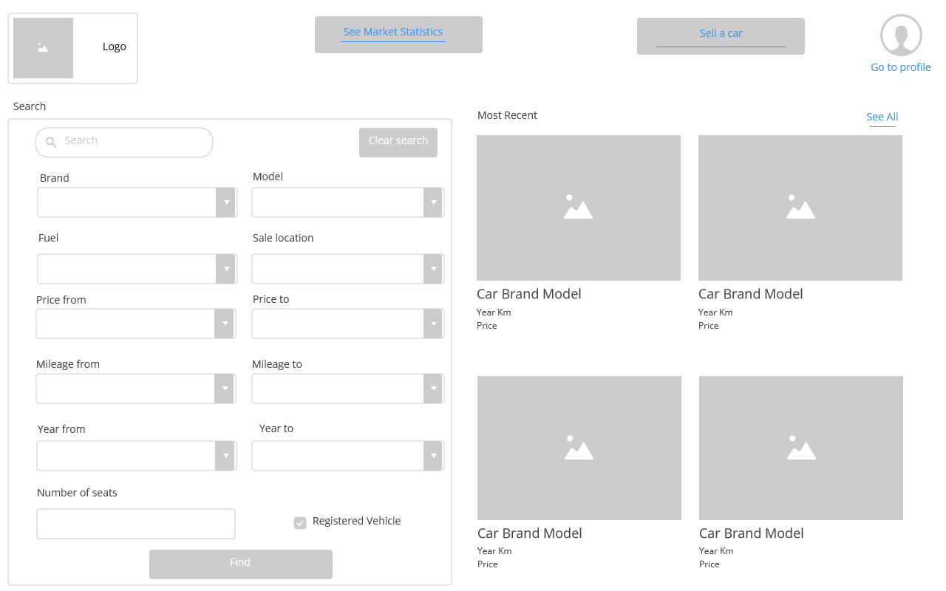
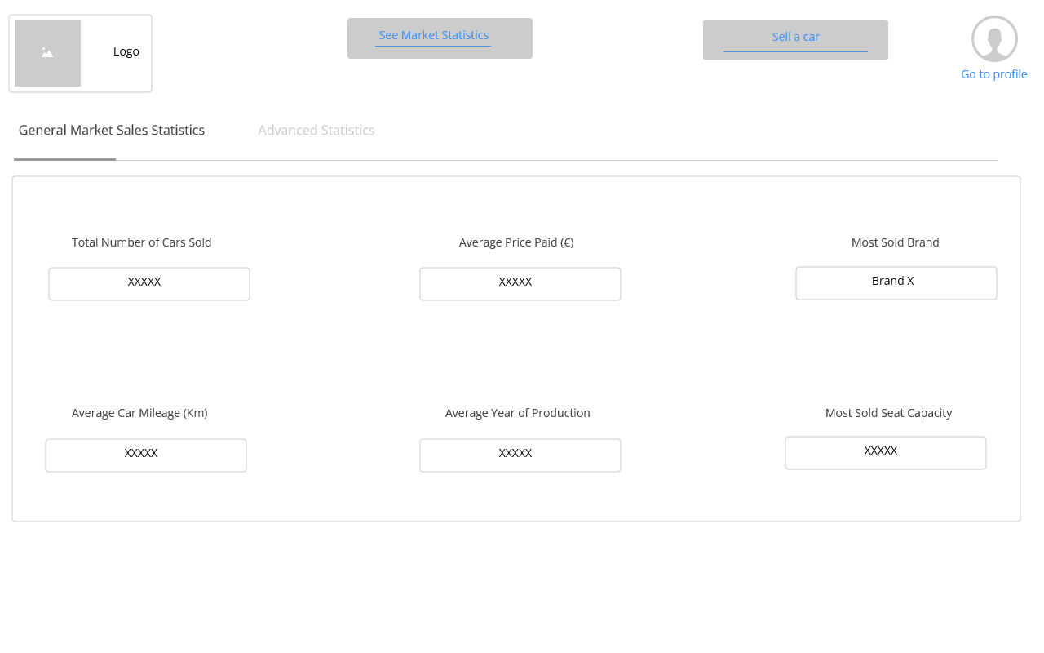
Low Fidelity Prototype (LFP)
Car Sales Platform
Digital Prototype made with prottapp.com
Homepage
General Statistics Tab
HCI 2021-2022
10

Slide 11
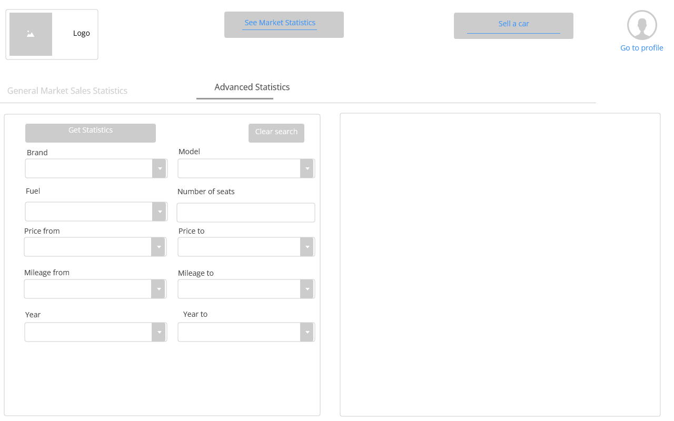
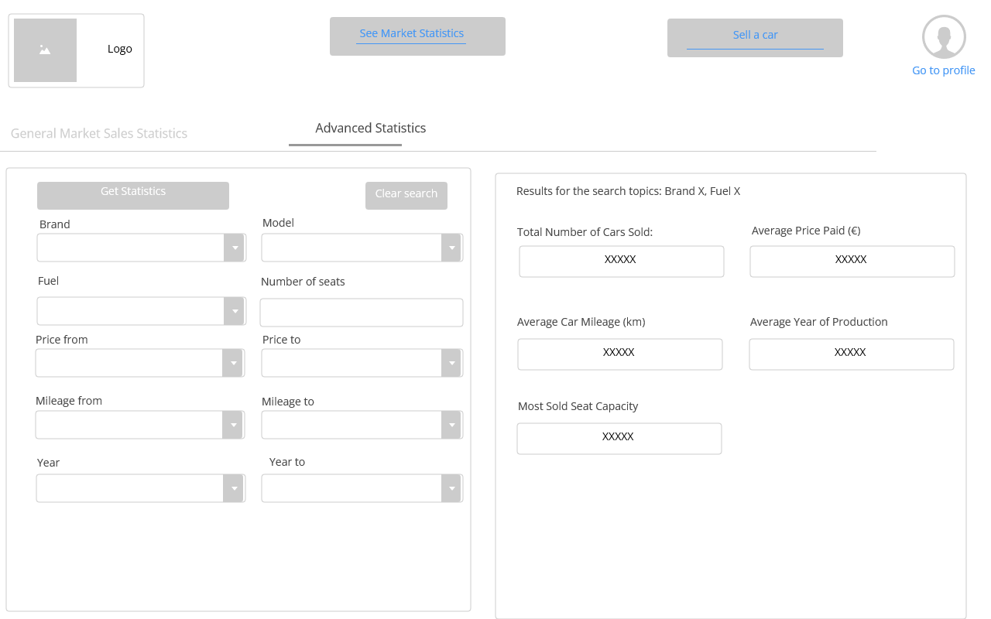
Low Fidelity Prototype (LFP)
Car Sales Platform
Digital Prototype made with prottapp.com
Advanced Statistics Tab
Advanced Statistics Search Result
HCI 2021-2022
11

Slide 12
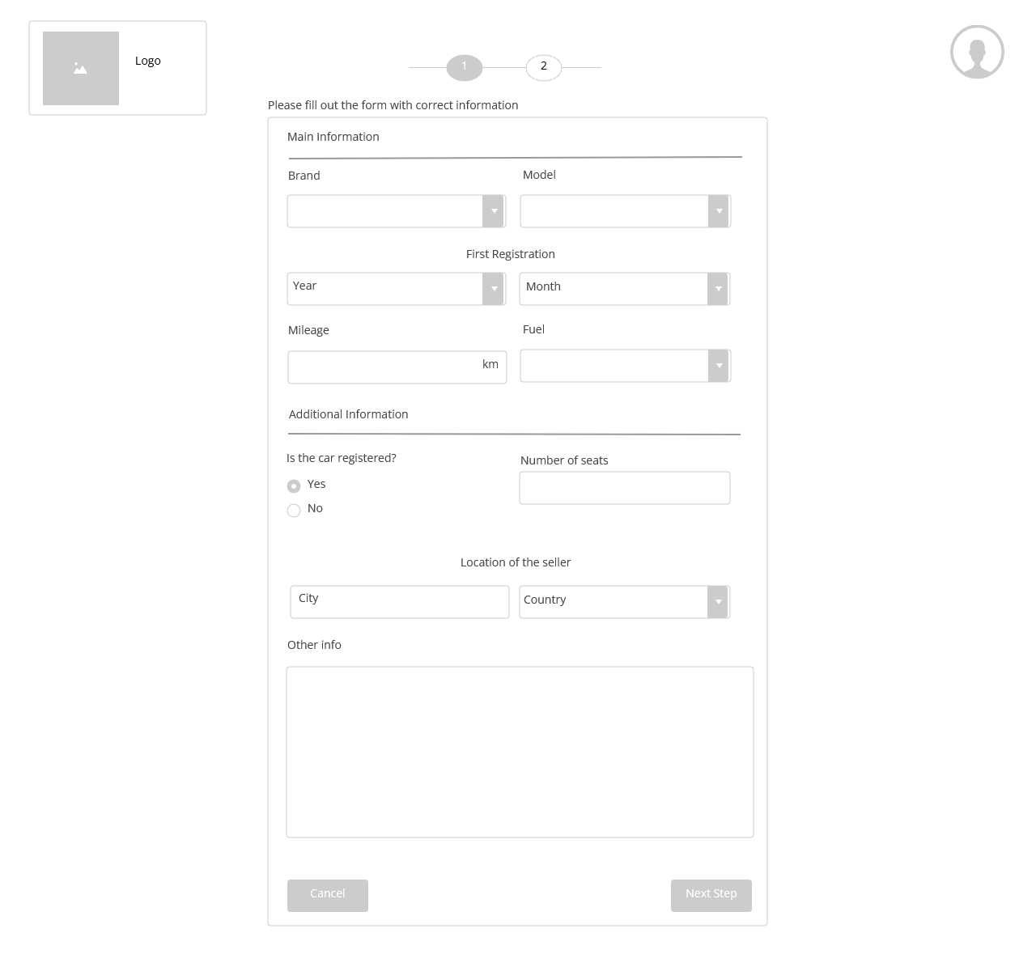
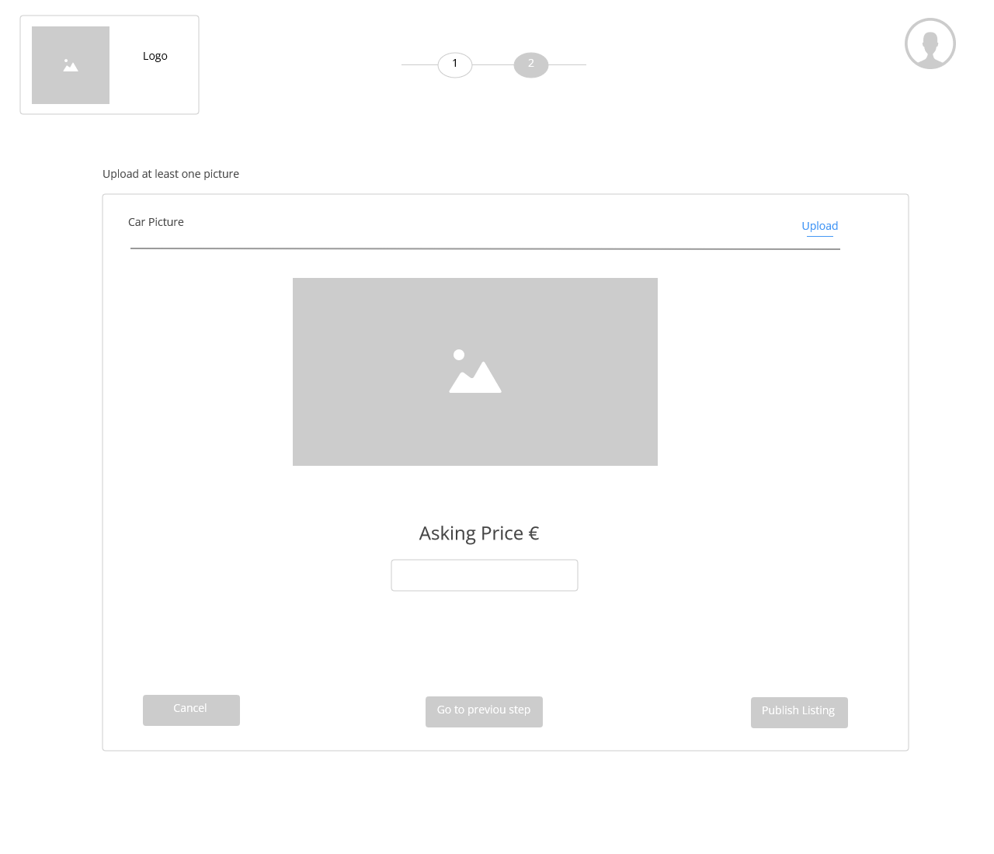
Low Fidelity Prototype (LFP)
Car Sales Platform
Digital Prototype made with prottapp.com
Sell Car Tab 1
Sell Car Tab 2
HCI 2021-2022
12

Slide 13
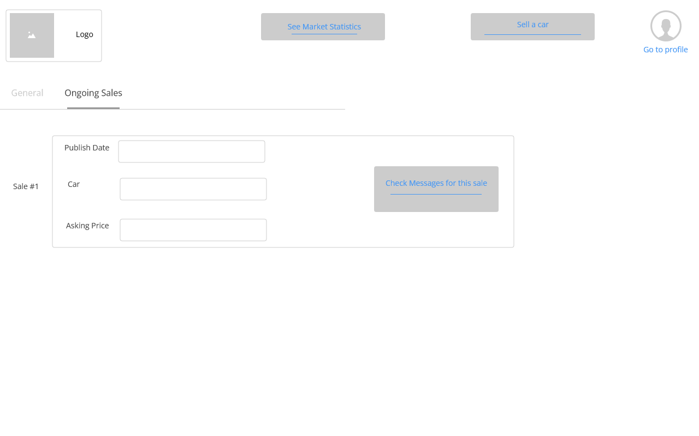
Low Fidelity Prototype (LFP)
Car Sales Platform
Digital Prototype made with prottapp.com
Ongoing Sales
HCI 2021-2022
13

Slide 14
LFP User Evaluation
Car Sales Platform
The goal was to perform the execution flow of the tasks and evaluate the efficiency of use and overall design of the system.
The personas and scenarios addressed were the ones previous mentioned in this presentation.
Tasks used:
Sell a car
Search for an Audi A4 costing under 3000€
Find the market statistics for an Audi A4 costing between 0€ and 10000€
Total of 5 participants
HCI 2021-2022
14

Slide 15
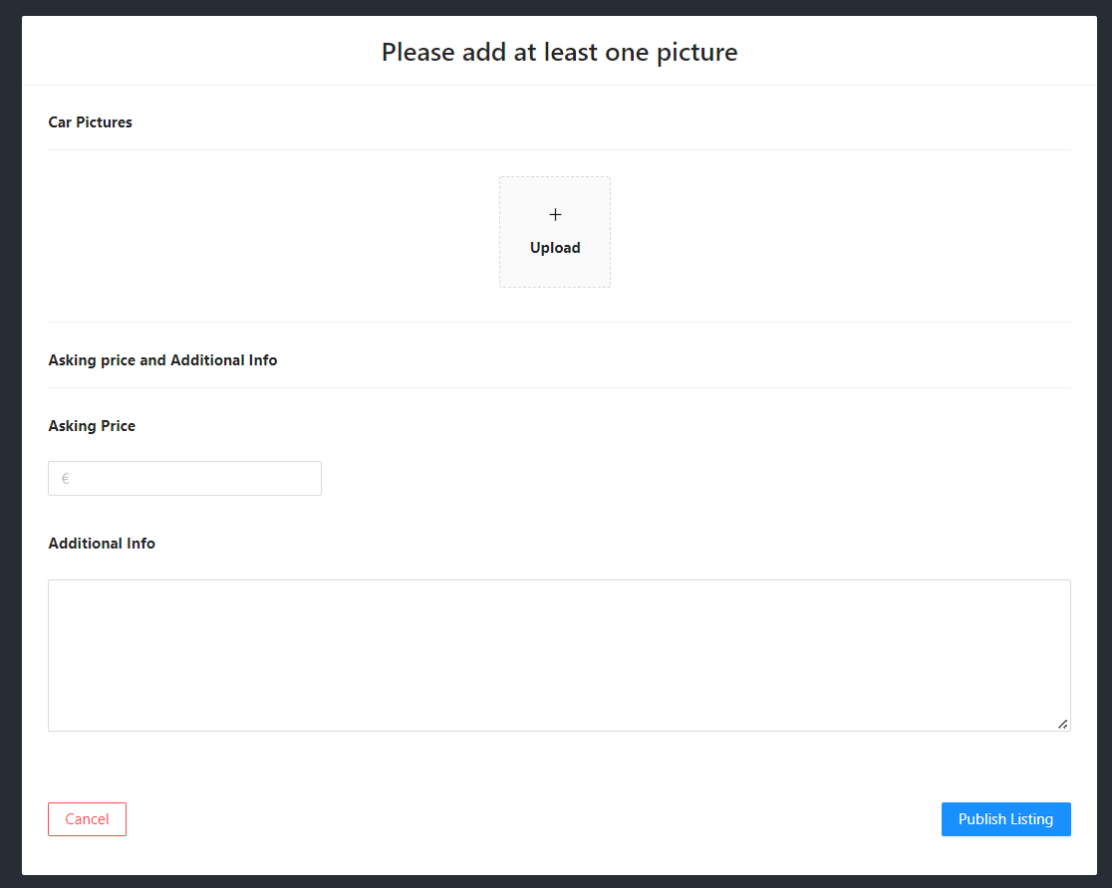
Low Fidelity Prototype (LFP)
Car Sales Platform
Update: Location of “other info” on car sale form
Before
After
HCI 2021-2022
15
Notes:
This is new material; should be presented in more detail

Slide 16
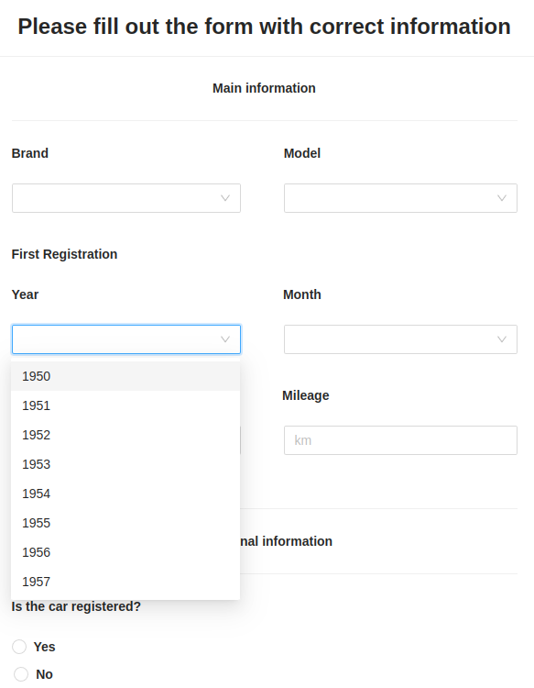
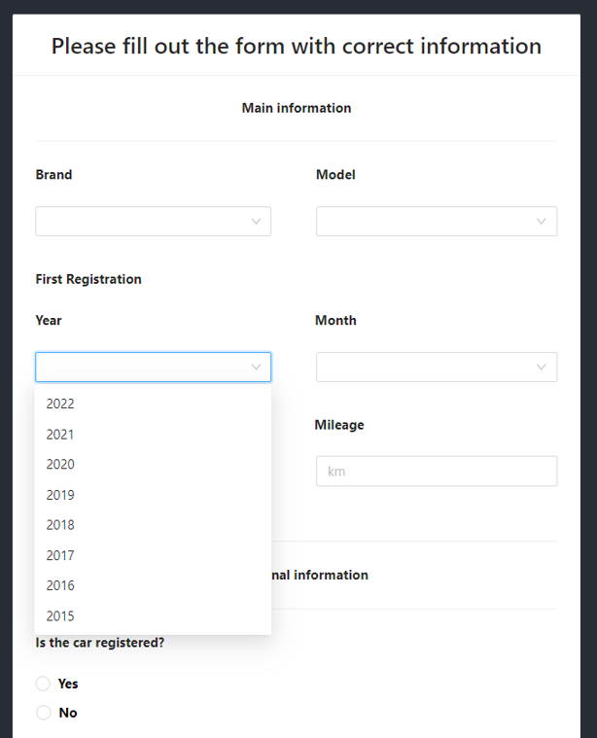
Low Fidelity Prototype (LFP)
Car Sales Platform
Update: Dropdown order
Before
After
HCI 2021-2022
16
Notes:
This is new material; should be presented in more detail

Slide 17
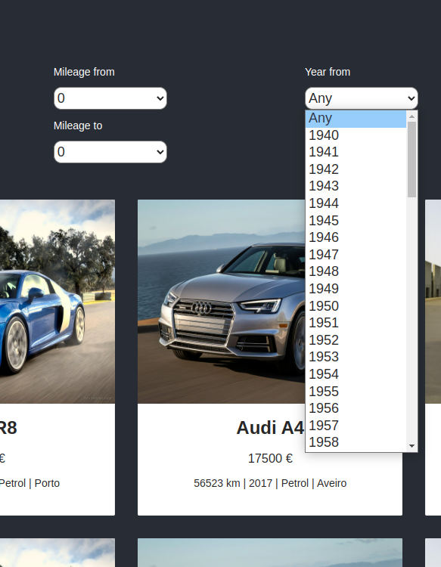
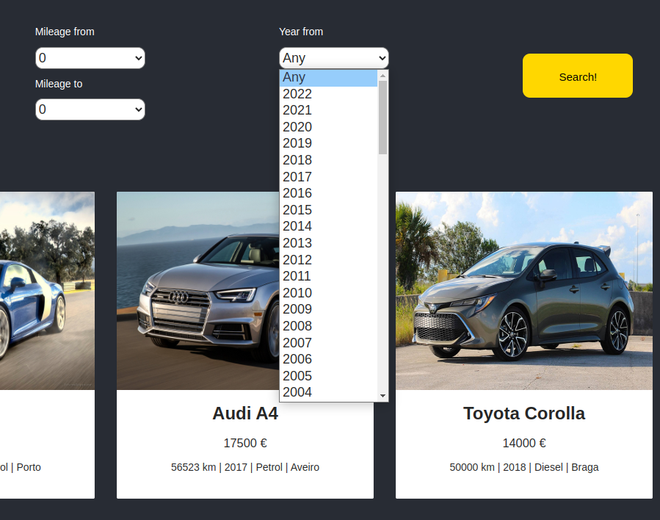
Low Fidelity Prototype (LFP)
Car Sales Platform
Update: Dropdown order
Before
After
HCI 2021-2022
17
Notes:
This is new material; should be presented in more detail

Slide 18


Platform Used for the functional prototype
Car Sales Platform
Implemented as a website using React.js and hosted on GitHub Pages
Recommended by the course teachers
Widely used in the industry
Large documentation available
HCI 2021-2022
18

Slide 19
User Evaluation of the functional prototype
Tested using the same personas, scenarios and tasks as the LFP evaluation.
Adapted post-task questionnaire from the one used in lab classes.
Recorded answers in Excel
Total of 5 participants
HCI 2021-2022
19

Slide 20
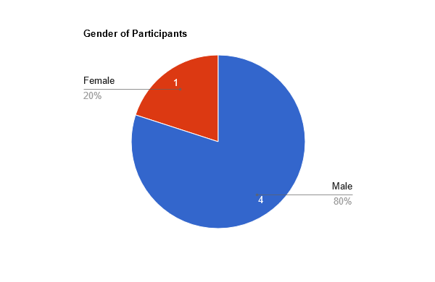
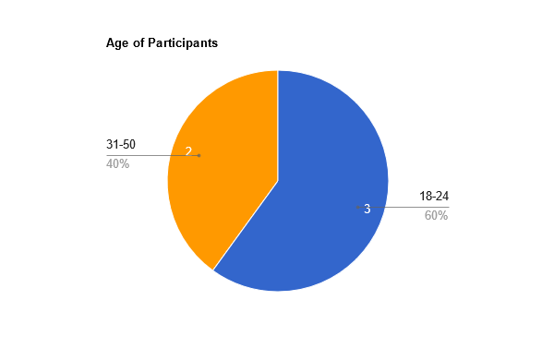
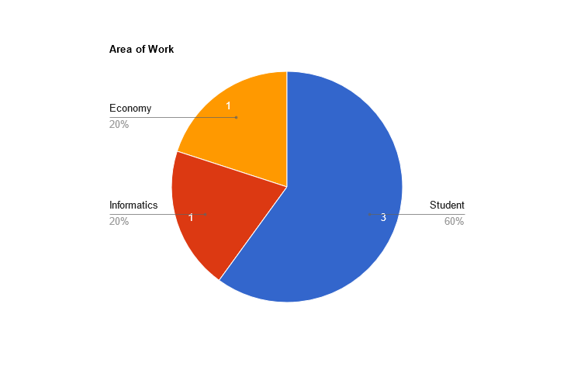
User Evaluation of the functional prototype
Participant Profiles
HCI 2021-2022
20

Slide 21
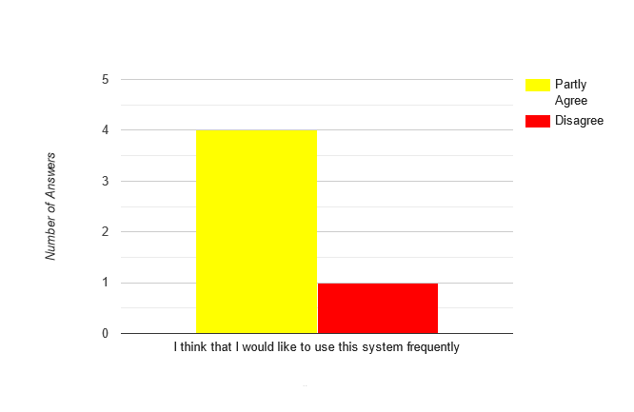
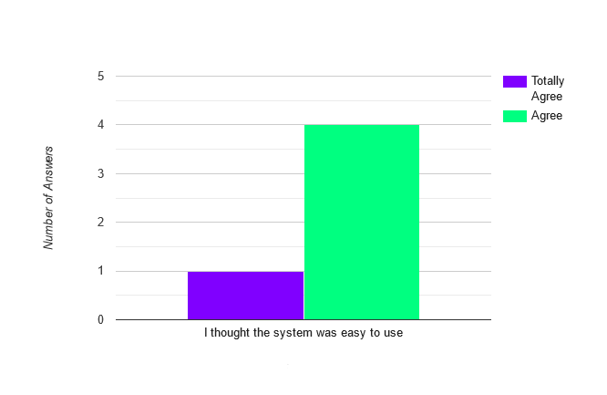
User Evaluation of the functional prototype
Results (1 being totally disagree and 5 totally agree)
HCI 2021-2022
21

Slide 22
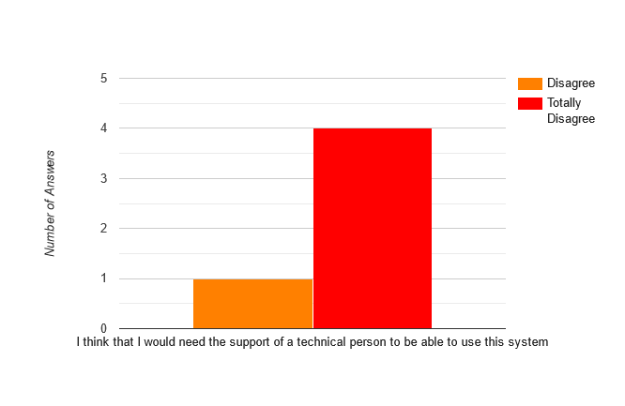
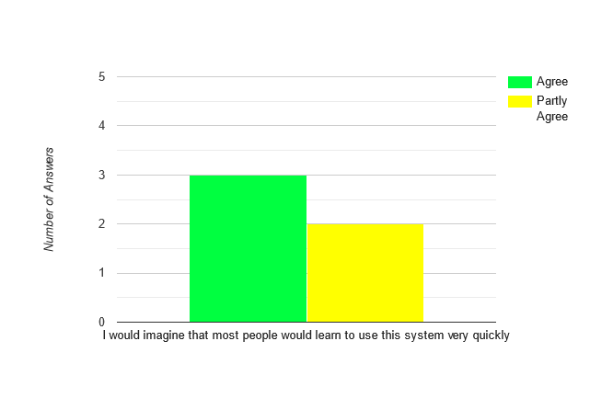
User Evaluation of the functional prototype
Results (1 being totally disagree and 5 totally agree)
HCI 2021-2022
22

Slide 23
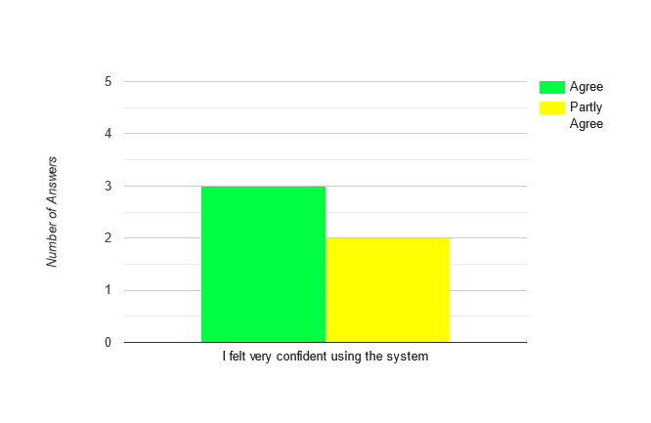
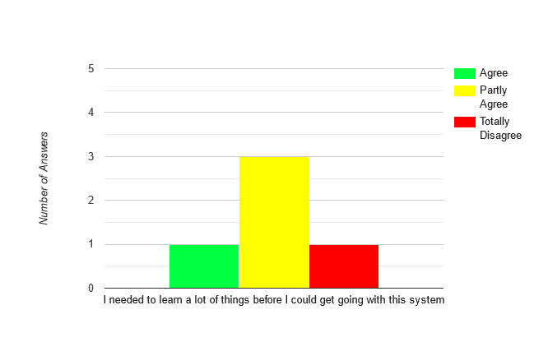
User Evaluation of the functional prototype
Results (1 being totally disagree and 5 totally agree)
HCI 2021-2022
23

Slide 24
Heuristic Evaluation of the functional prototype
Based on Nielsen's 10 general principles for interaction design
Severity scale from 0 to 4
 |  | Participant 1 |  | Participant 2 |  | Participant 3
Usability Issue | Heuristic | Found | Severity | Found | Severity | Found | Severity
UI seems unfinished | Aesthetic and minimalist design | ✔ | 3 | ✔ | 3 | ✔ | 2
No confirmation on sale posting | Visibility of system status | ✔ | 2 | ✔ | 2 |  | 1
Impossible to return to page 1 of sale form when on page 2 | User control and freedom | ✔ | 2 |  | 1 | ✔ | 2
Cant write own search field | User control and freedom | ✔ | 2 | ✔ | 2 | ✔ | 2
HCI 2021-2022
24

Slide 25
User Evaluation of the functional prototype
Results
Looking at the results from the user evaluation and heuristic evaluation, it was concluded that:
The core ideas and functionalities designed are appropriate
The system is easy to use and does not require great technically skill
Although easy to navigate, the UI requires additional work in order to be more “user-friendly” and an improvement on the original prototype
Main Difficulties
Due to time constraints, the UI is still not as polished and completed as expected
Functionality of buying a car is not implemented
HCI 2021-2022
25

Slide 26
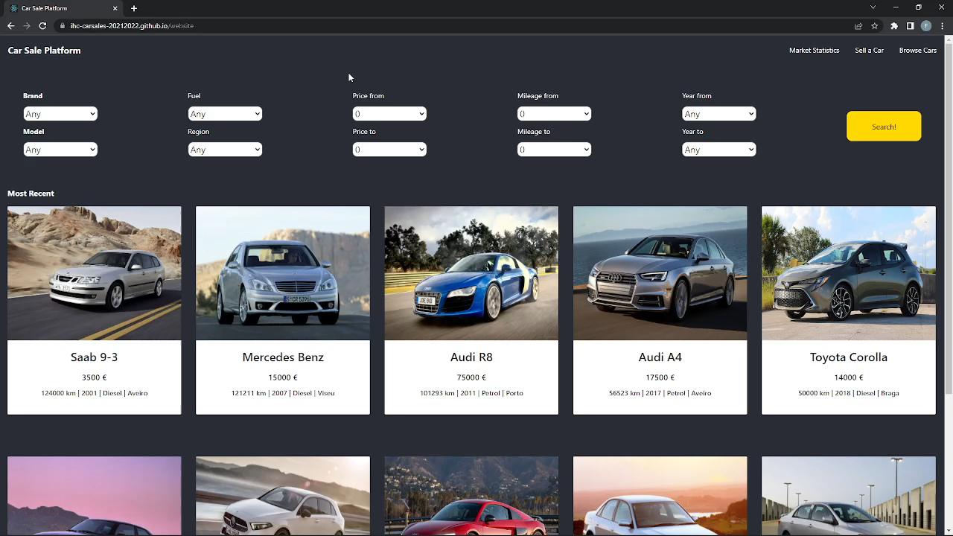
Demo
Car Sales Platform
HCI 2021-2022
26

Slide 27
Future work
Improvement of UI aspects
Implementation of database
Implementation of real time chat room between seller and buyer
Effort of each group member
Same effort by all members
HCI 2021-2022
27

Slide 28
Acknowledgments
Course Teachers for their guidance
Class colleagues for their help with evaluations
Bibliography
Resources available on eLearning
Several tutorials on the internet
HCI 2021-2022
28

